Slide 1
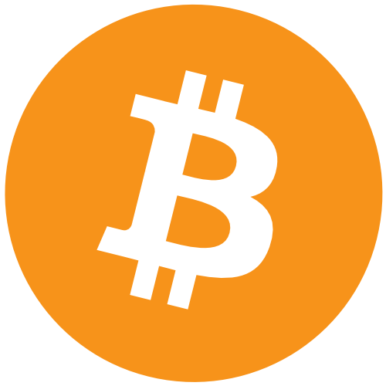
Bitcoin Oriented social media application
MEAN STACK powered bitcoin wallet PROJECT By conor, donal and Stephan

Slide 2
Original Project Objectives:
Our goal is to make a Bitcoin Wallet using the MEAN stack by combing of NodeJs,Angular2,ExpressJs and MongoDB
Make the UI user friendly and appealing to new users of Bitcoin.
Educate user on the technology bitcoin and how it works, display real time value.
Strong authentication that’s simple to use yet secure so users will trust us with there coins.
Google Maps integration to show users bitcoin related locations like exchanges or stores that accept the currency.
Use QR codes to easily send and receive coins.

Slide 3




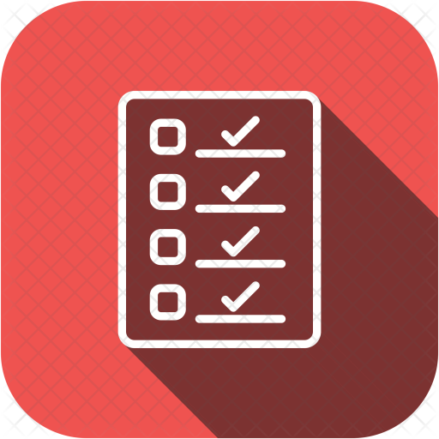
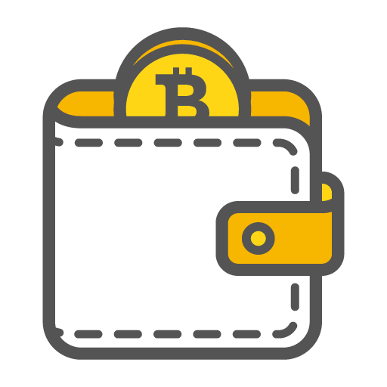
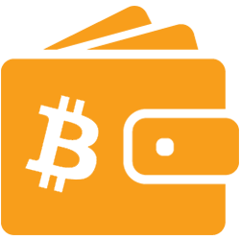
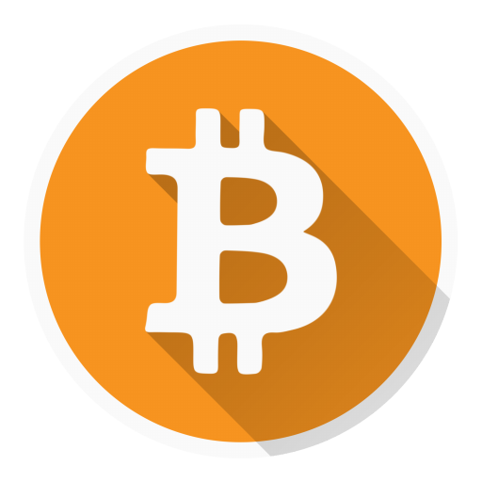
Project main Features
Secure and Authenticated accounts.
View the latest cryptocurrency news, prices, conversion rates and chart's
Write blogs locally to communicate or share information with users
Post statuses that reference the most up to date blockchain, miner and wallet statistics, share the location of these with friends.
Connect with others online, add them as friends, view their location on the map
All addresses protected by pin
Create and share addresses between users
RECEIVE/ SEND BTC

Slide 4

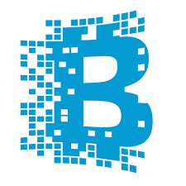



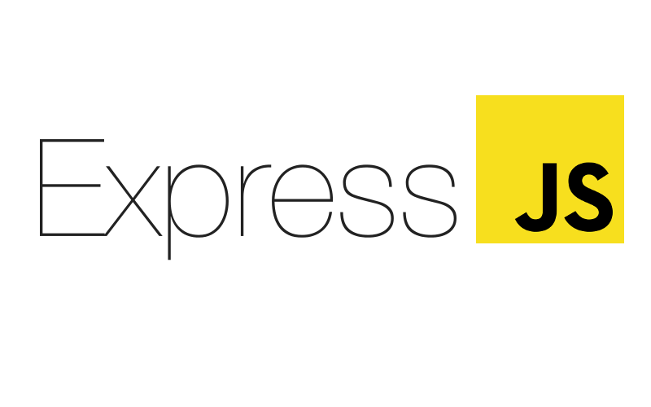

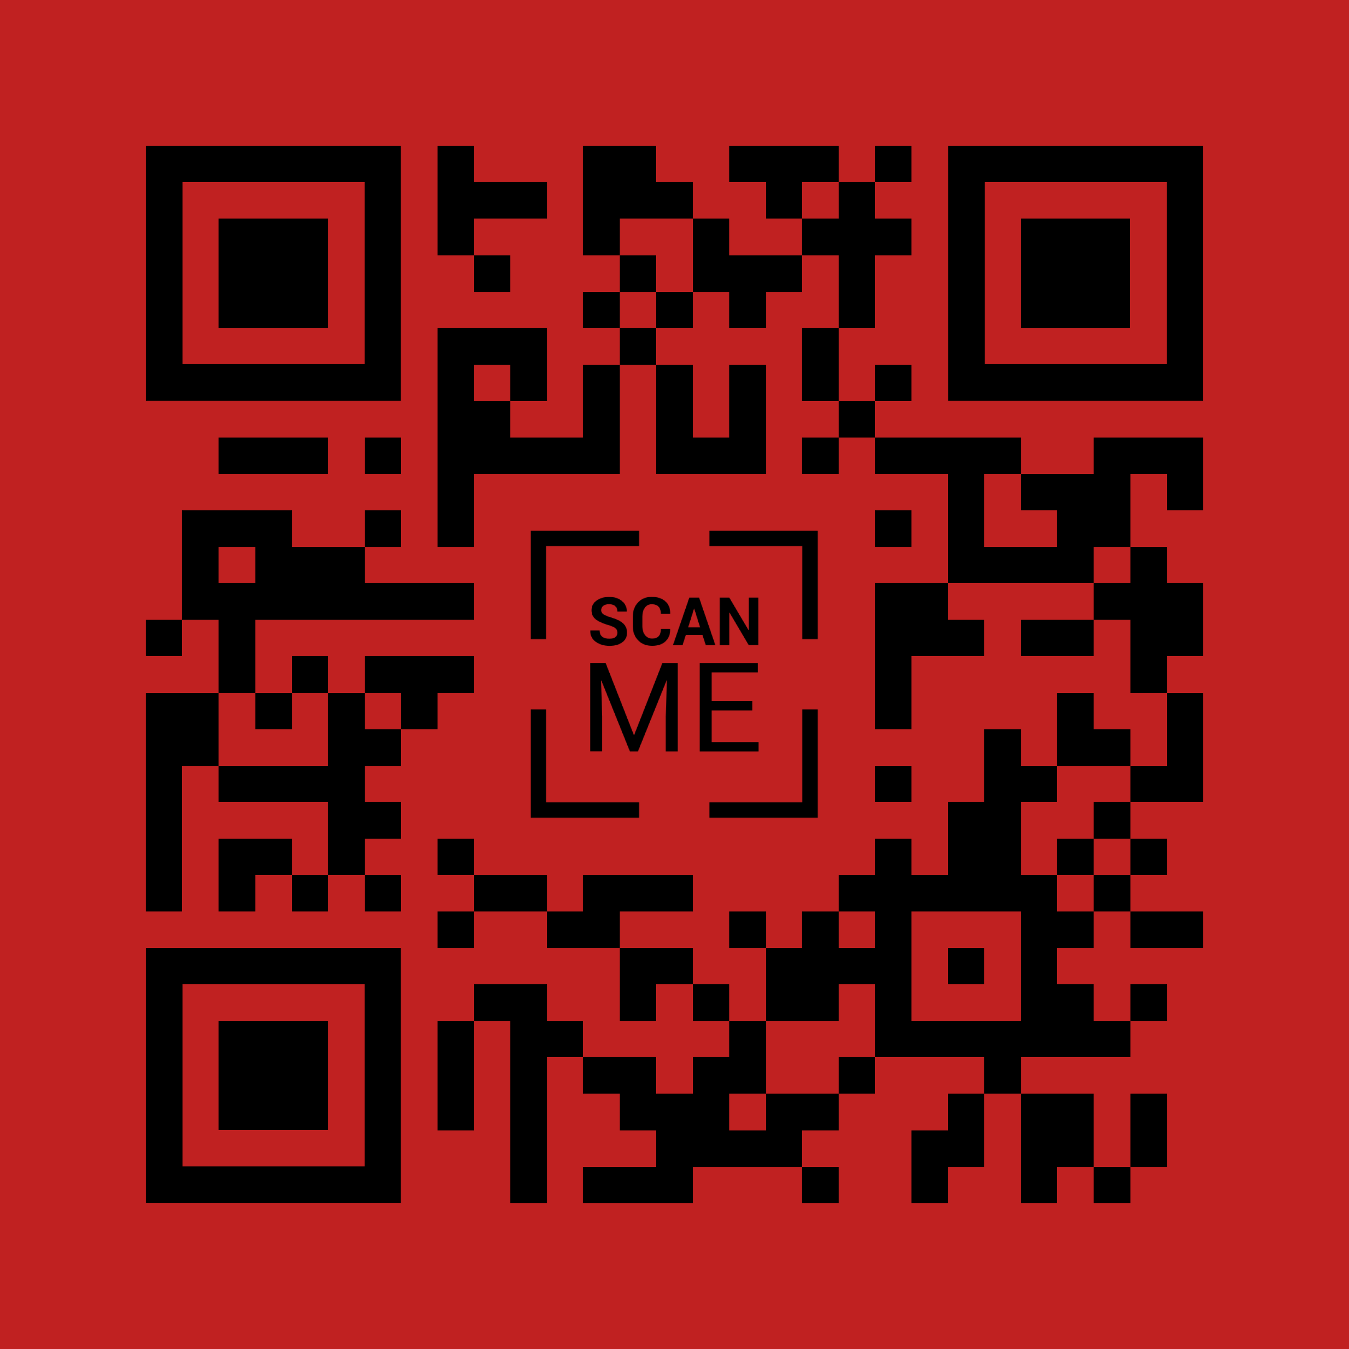
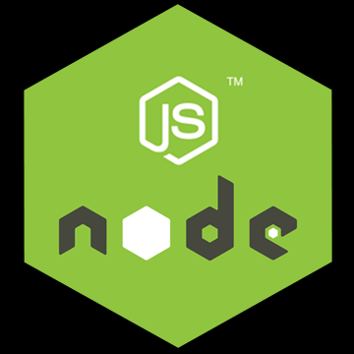


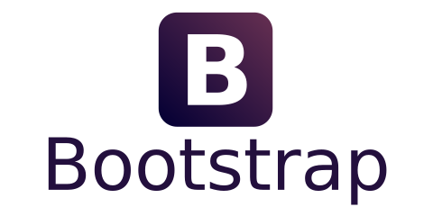
Architecture
Blockchain security client

Slide 5

Testing
Browser Test cases done through the selenium
Test cases included:
Login test case.
Register test case.
Failed login test case.
Menu page navigation test case
End user Testing
Testing carried out by friends, family and peers. Taking note of the feed back and how they interacted with the application. Providing information and where improvements could be made

Slide 6
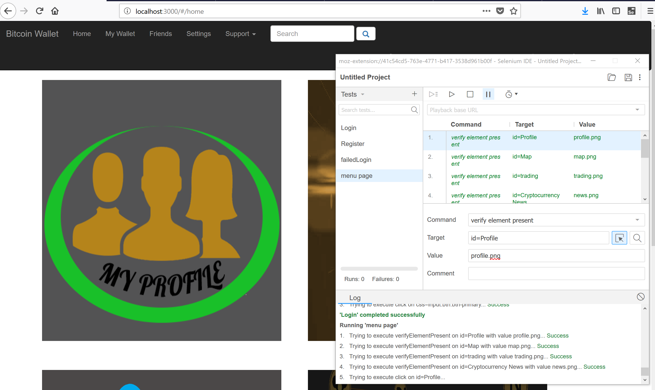
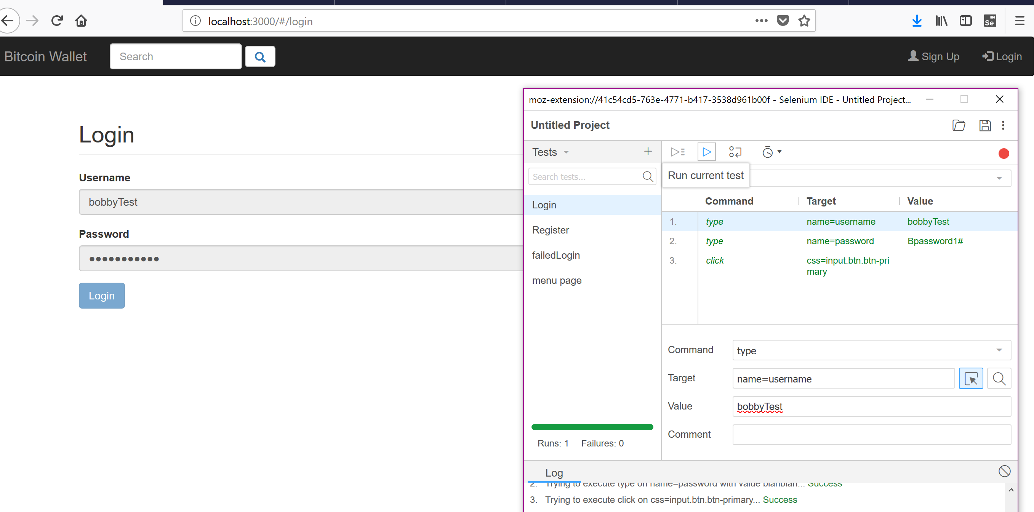
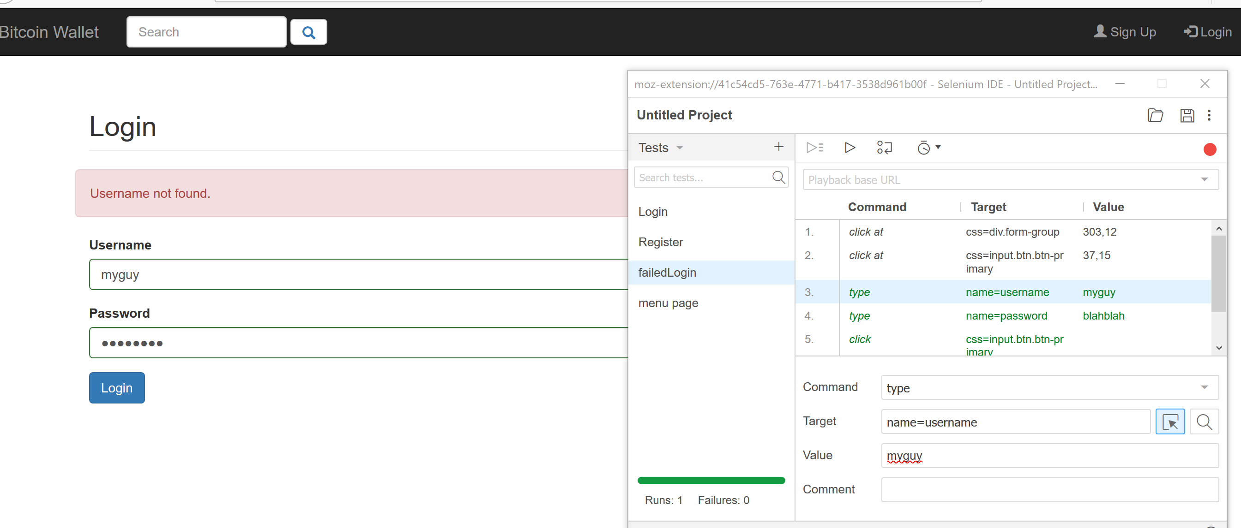
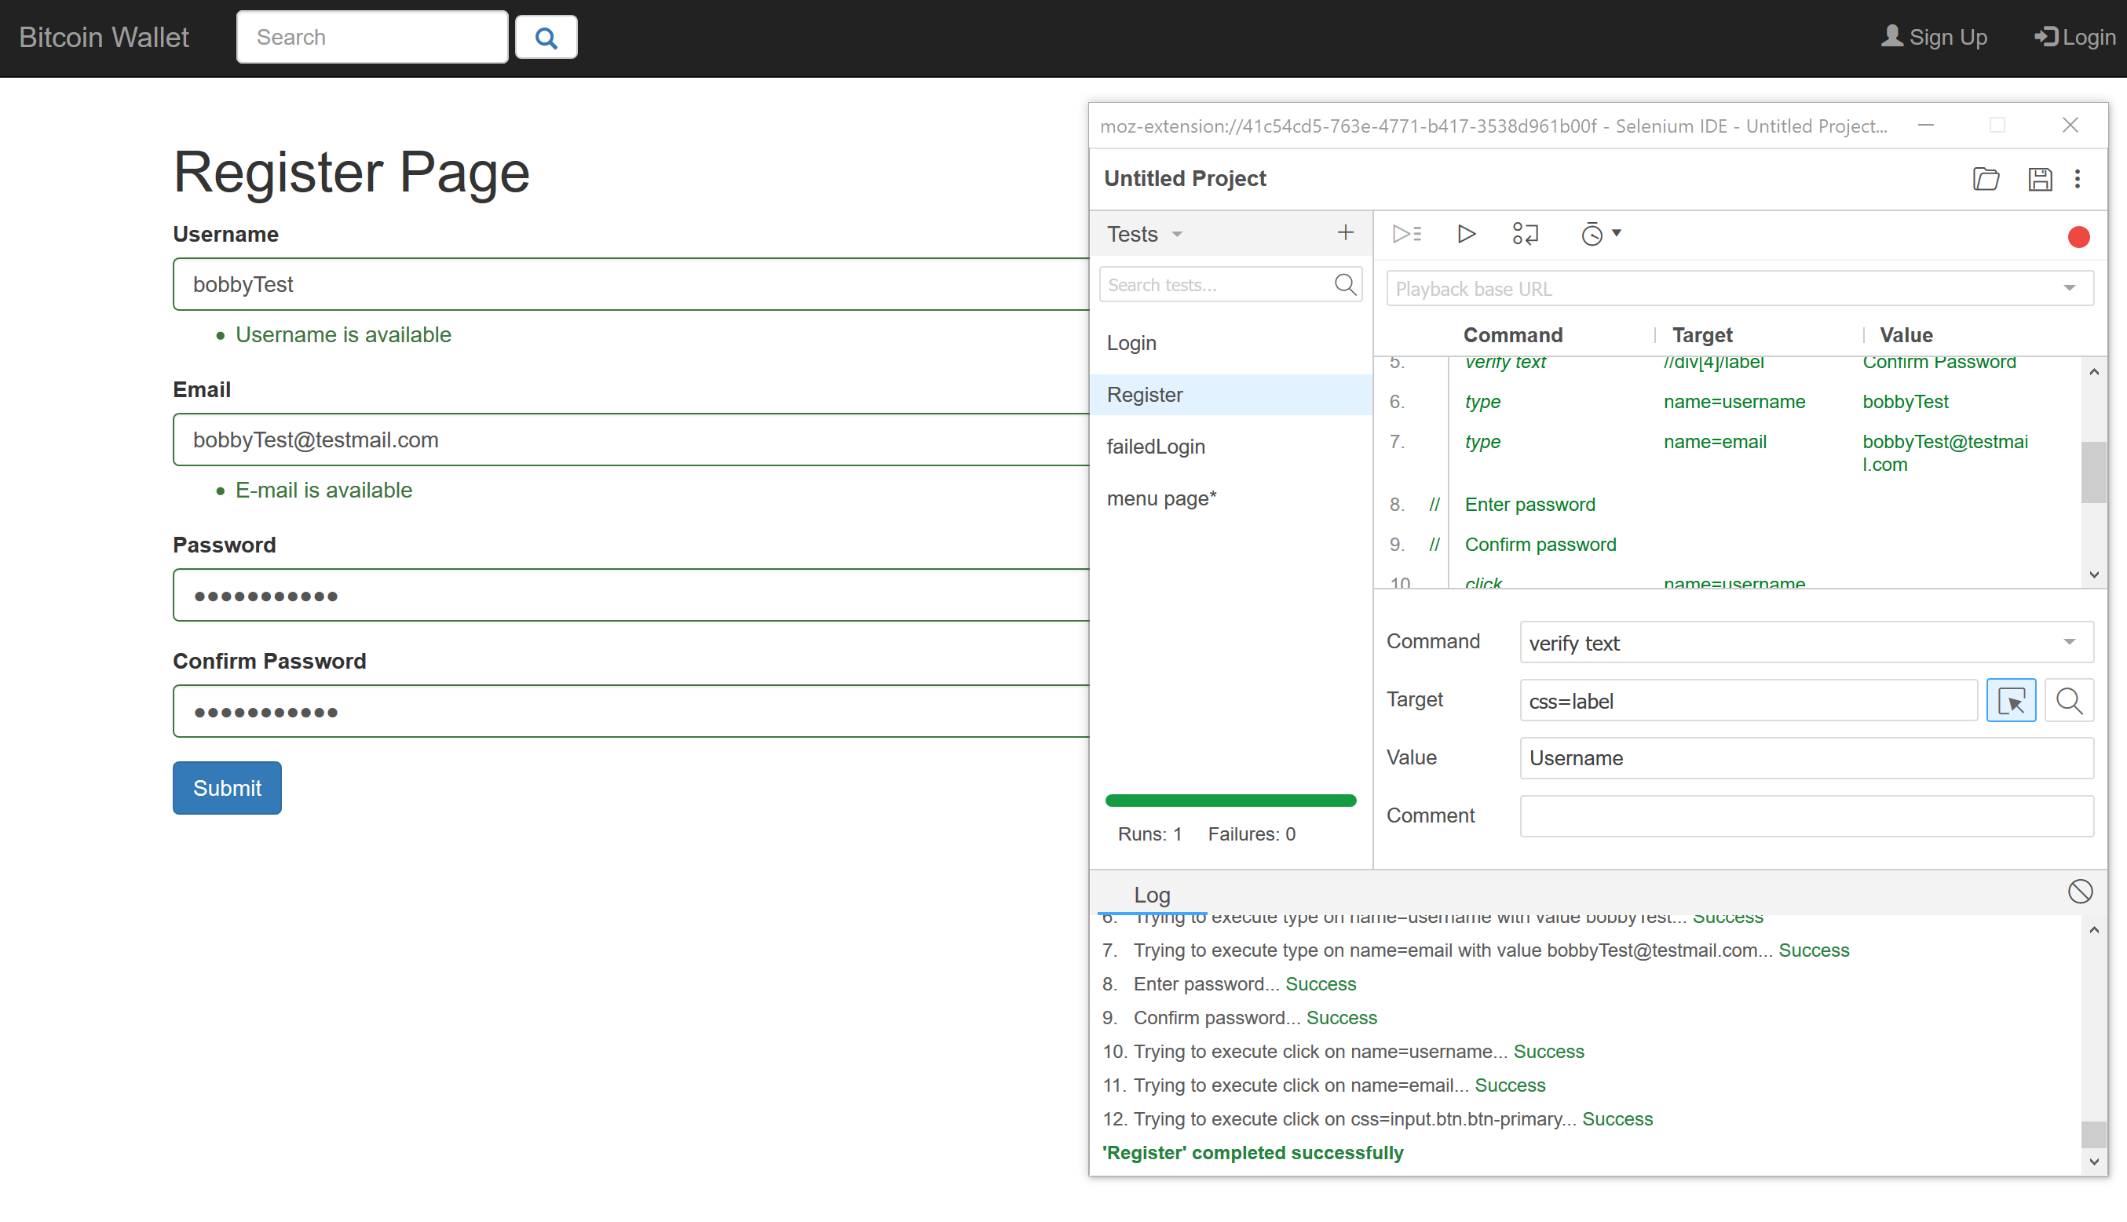
Menu Page Test Case
Login Test Case
Failed Login Test Case
Register Test Case

